Slide 1

Micro Frontend

Slide 2
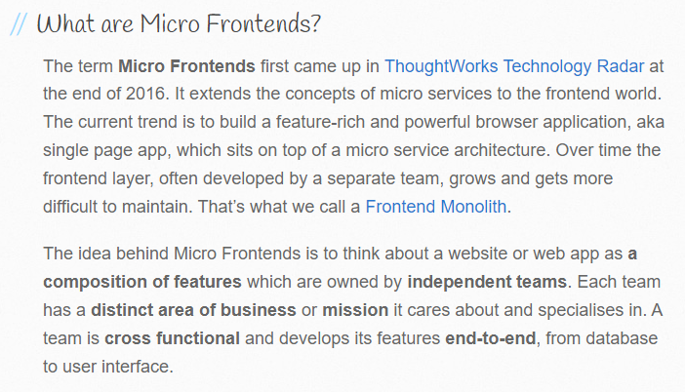
Introduction
What are Micro Frontends

Slide 3
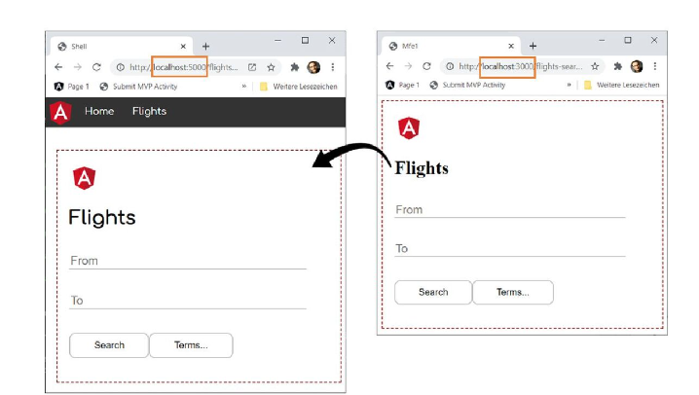
Runtime Integration

Slide 4
Introduction
Technology agnostic
Isolate team code
Establish Team prefixes
Use Native browser events for communications
Use of universal rendering (SSR)

Slide 5
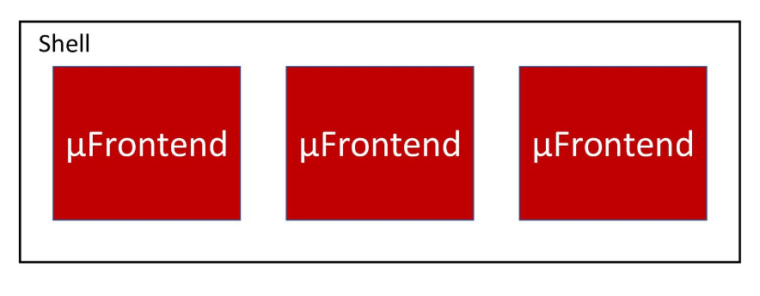
Shell based integration
Outer Shell application (main route)
Separate application per domain

Slide 6
Shell based integration - Options
Iframe
Bootstrap several SPAs
e.g. single-spa
Web components
Module Federation
Webpack 5+ esbuild ? Need extra work

Slide 7
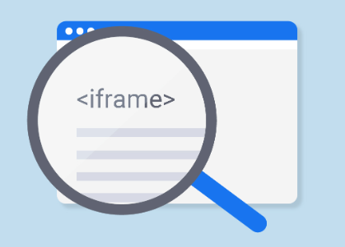
iframe
Easy to use
Communication considerations
styling difficulties
deployment

Slide 8


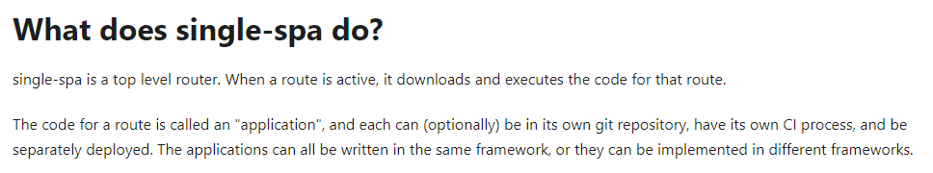
Single spa
12.8K Stars
Host need to make changes
Community backed
Configuration of shared dependencies

Slide 9
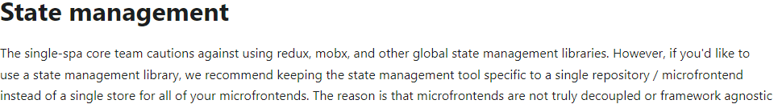
Single spa

Slide 10
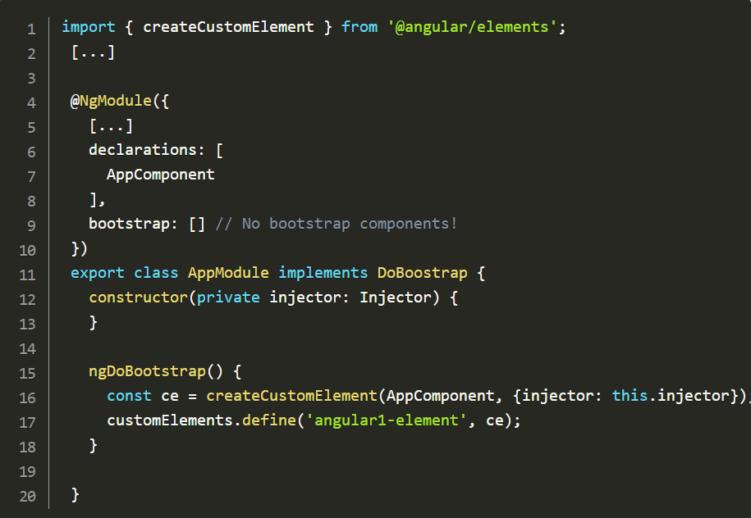
Web Components – Angular Elements

Slide 11
Web Components – Angular Elements
Build element
Concatenate all bundle files + css
Give to our “customers”
Load .js in the index.html
Use the component’s tag
** we can also use standalone components

Slide 12
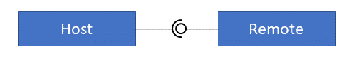
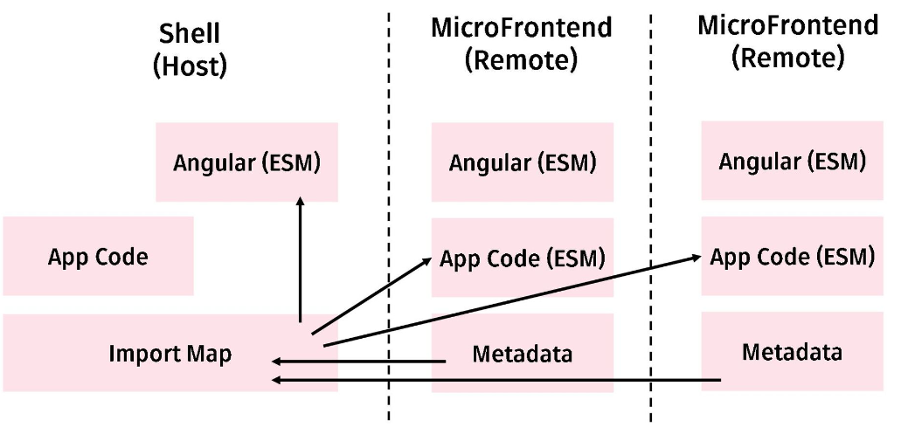
Module Federation – Webpack 5+

Slide 13


Slide 14
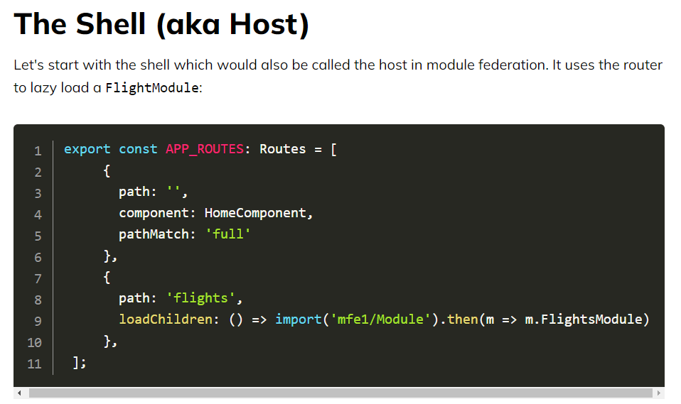
Micro Frontends - Module Federation

Slide 15
Micro Frontends - Module Federation

Slide 16
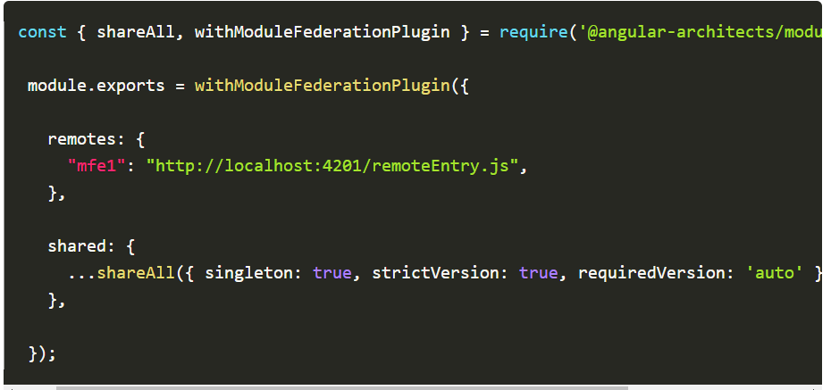
Micro Frontends - Module Federation
Webpack.config.js - HOST
Note: singleton, strictVersion

Slide 17
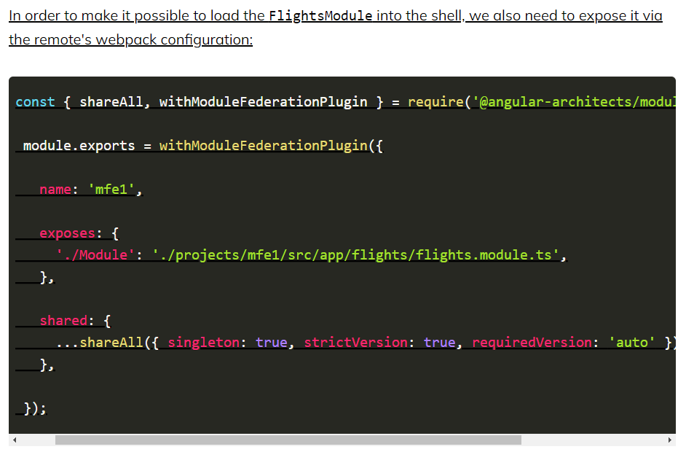
Micro Frontends - Module Federation
Webpack.config.js - REMOTE

Slide 18
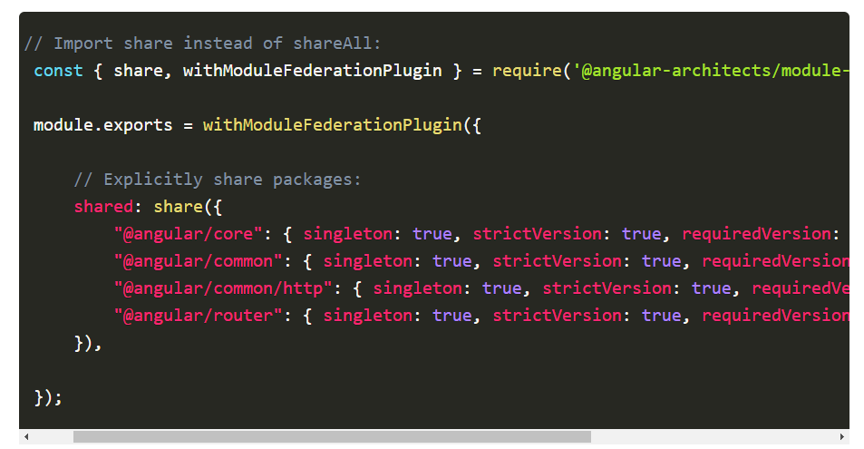
Micro Frontends - Module Federation
Webpack.config.js – Sharing Dependencies

Slide 19
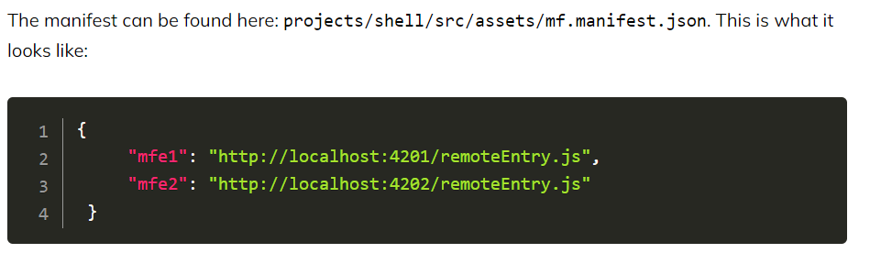
Micro Frontends - Module Federation
Dynamic module federation – HOST !

Slide 20
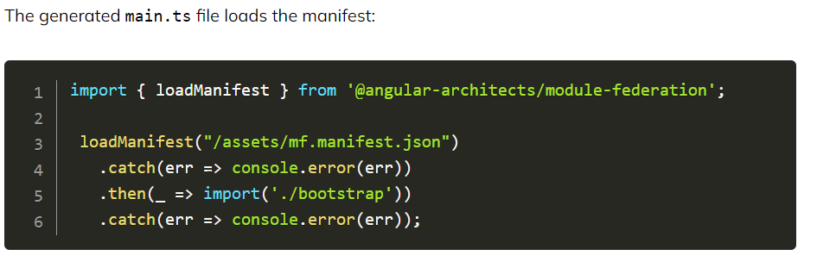
Micro Frontends - Module Federation
Dynamic module federation – HOST !

Slide 21
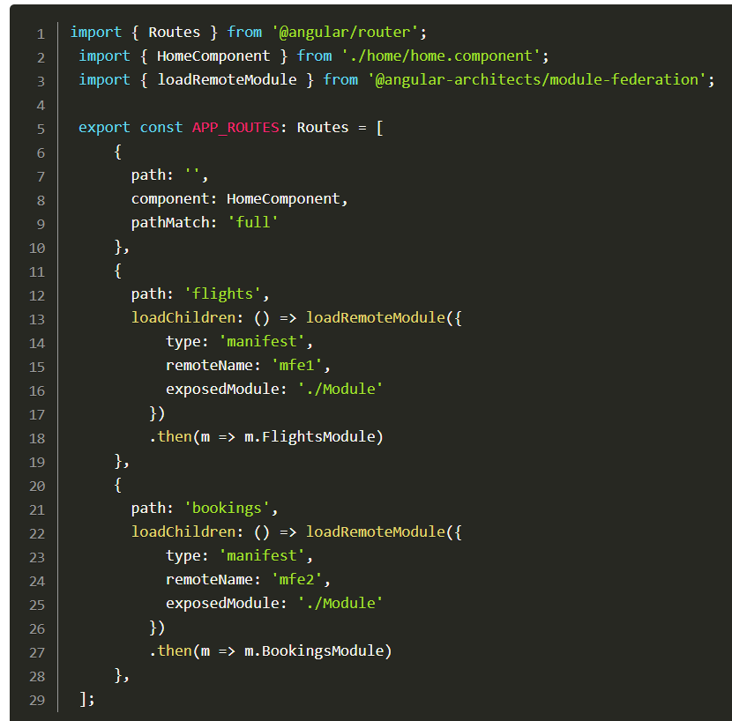
Micro Frontends - Module Federation
Dynamic module
federation – HOST !

Slide 22
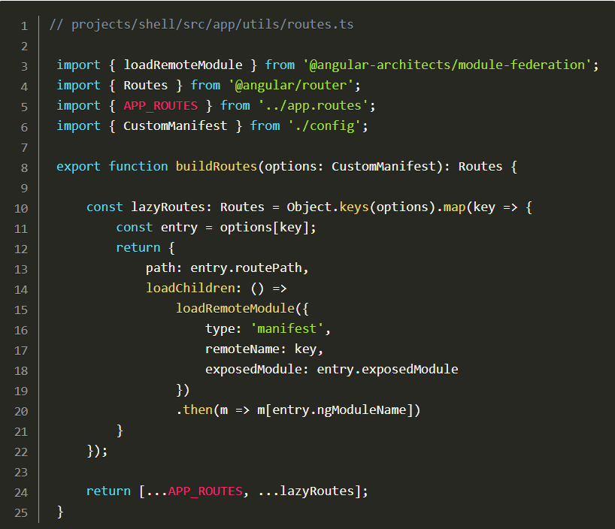
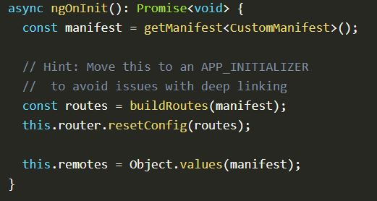
Micro Frontends - Module Federation
Dynaically creating
Routes !

Slide 23
Micro Frontends - Module Federation
Using the angular/cli
npm I @angular-architects/module-federation –save-dev
ng new mono-workspace --createApplication="false"
cd mono-workspace
ng g application host-app --routing --style=scss
ng g application mfe-app --routing --style=scss
npm i webpack webpack-cli --save-dev
ng add @angular-architects/module-federation --project host-app --port 4200
ng add @angular-architects/module-federation --project mfe-app --port 4300

Slide 24
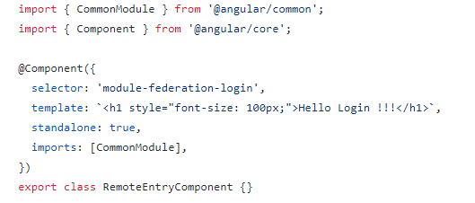
Micro Frontends - Module Federation

Slide 25
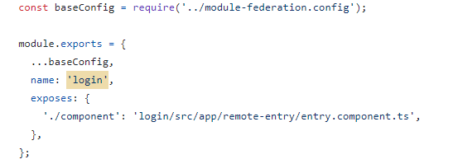
Micro Frontends - Module Federation

Slide 26
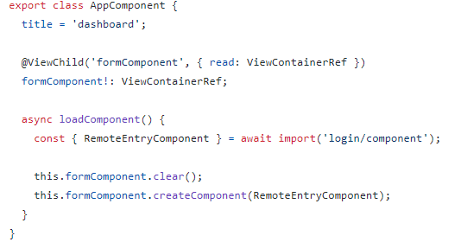
Micro Frontends - Module Federation

Slide 27


Micro Frontends - NX
https:/nx.dev

Slide 28
Micro Frontends - NX
Tooling
Vscode integration
CI/CD helpers
Caching
Fast builds / affected
Cypress / storybook integration

Slide 29
Micro Frontends - NX
Npx create-nx-workspace@latest angular-monorepo --preset=angular-monorepo
For the meantime, use webpack and not esbuild (16,17)
https://nx.dev/recipes/module-federation/create-a-remote

Slide 30
Questions ?

